Slide 1
Sales Analytics

Slide 2
Introduction :-
Sales Analytics is the process of collecting, analyzing, and interpreting sales data to gain meaningful business insights and support data-driven decision-making. It helps organizations understand sales performance, customer behavior, product demand, market trends, and revenue patterns.
By using analytical tools and visualization platforms such as Microsoft Power BI, businesses can transform raw sales data into interactive dashboards and reports that provide real-time insights into key performance indicators (KPIs). Sales analytics enables organizations to identify top-performing products, profitable customer segments, regional sales trends, and operational inefficiencies.
The primary objective of sales analytics is to improve business performance by optimizing sales strategies, forecasting future demand, enhancing customer satisfaction, and increasing overall profitability. Through the use of charts, graphs, and statistical analysis, companies can monitor metrics such as total sales, sales growth, order value distribution, shipping performance, employee productivity, supplier contribution, and product category performance.

Slide 3
Problem Statement / Business Objective
Problem Statement :-
A company generates large amounts of sales data from customers, products, orders, and different regions. However, the business is unable to clearly understand sales performance, customer behavior, product demand, and profitability due to scattered and unstructured data.
The company wants to analyze sales data to identify revenue trends, top-performing products, customer purchasing patterns, regional performance, and business profitability for better decision-making.
Business Objective :-
The objective of sales analytics is to:
Monitor overall sales and revenue performance
Identify top and low performing products
Understand customer buying behavior
Analyze order and purchasing trends
Evaluate regional sales performance
Detect seasonal and time-based demand patterns
Improve inventory and supply planning
Increase profitability and business growth

Slide 4
Dataset Overview :-
Dataset Source :-
The dataset used in this project was collected from AccioJob for learning and analytical purposes. The dataset contains sales-related information such as customers, products, orders, suppliers, and transactions used to perform sales analytics and business intelligence reporting.
Number of Tables :-
The dataset contains the following tables:
Customers
Orders
Order_Details
Products
Categories
Suppliers
Employees
Shippers

Slide 5
Microsoft Excel
Excel was used for :-
Initial data understanding
Data cleaning and preprocessing
Creating pivot tables and charts
Performing basic analysis and formatting
2. SQL
SQL was used to :-
Query and analyze sales data
Perform joins between tables
Calculate KPIs and business metrics
Filter and aggregate data
3. Power BI
Power BI was used for :-
Interactive dashboard creation
Data visualization
KPI monitoring
Business reporting

Slide 6
Data Cleaning & Preprocessing :-
Data cleaning and preprocessing were performed to improve data accuracy and consistency. This included handling missing values, removing duplicates, fixing data types, standardizing formats, and creating calculated columns such as Total_Sales for better analysis.
Handling missing values
Removing duplicates
Fixing data types
Standardizing formats
Handling null values
Creating calculated columns
Example :-
Converted Order_Date into date format
Removed duplicate customer records
Created Total_Sales column = Quantity × Unit_Price

Slide 7
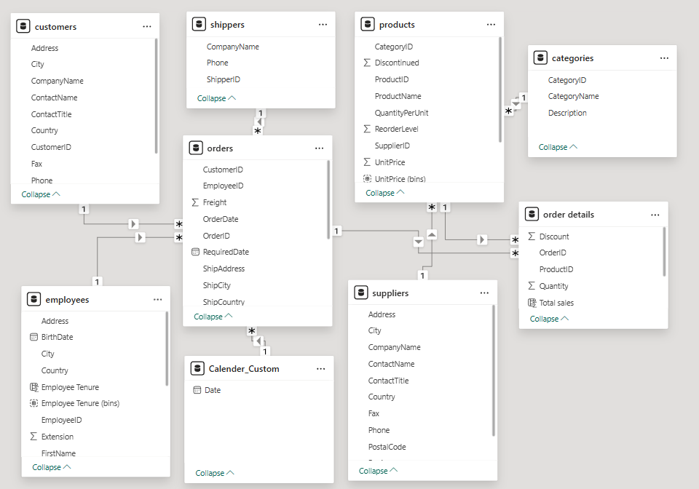
Data Modeling:-
ER-Diagram:-

Slide 8
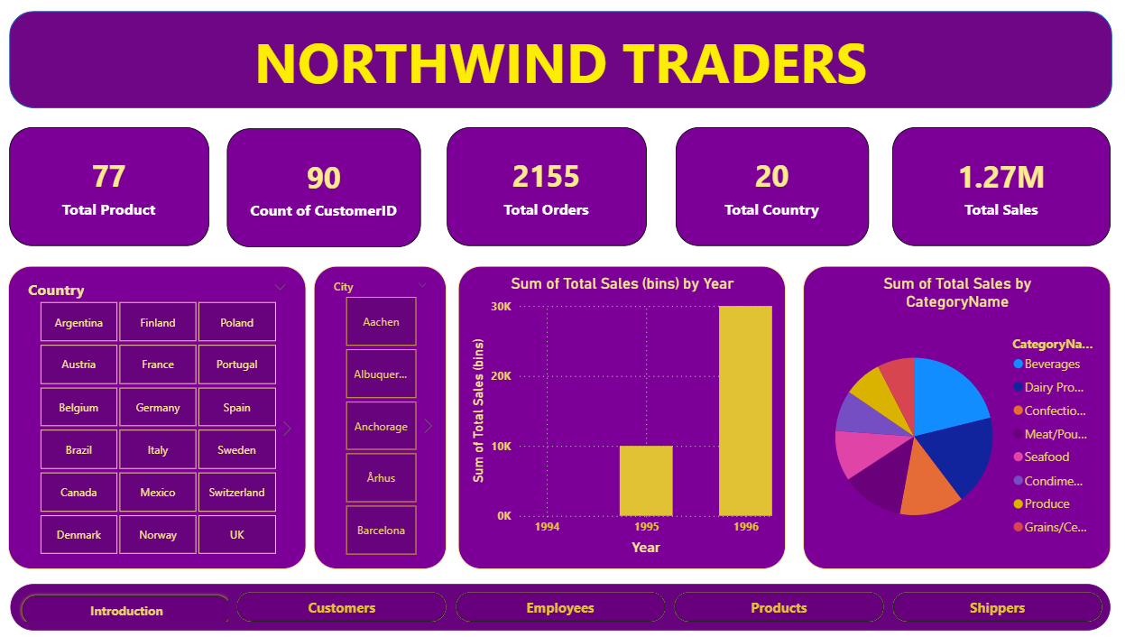
Dashboard Overview :-

Slide 9
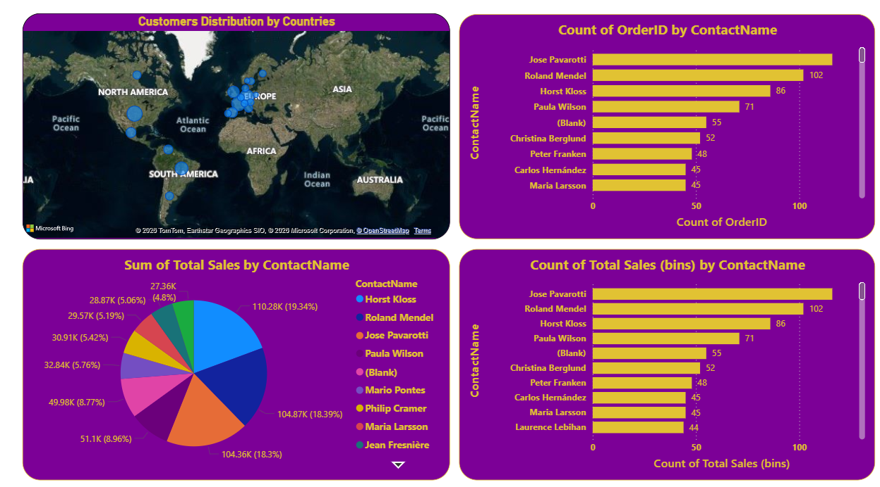
Customers Metrics :-

Slide 10
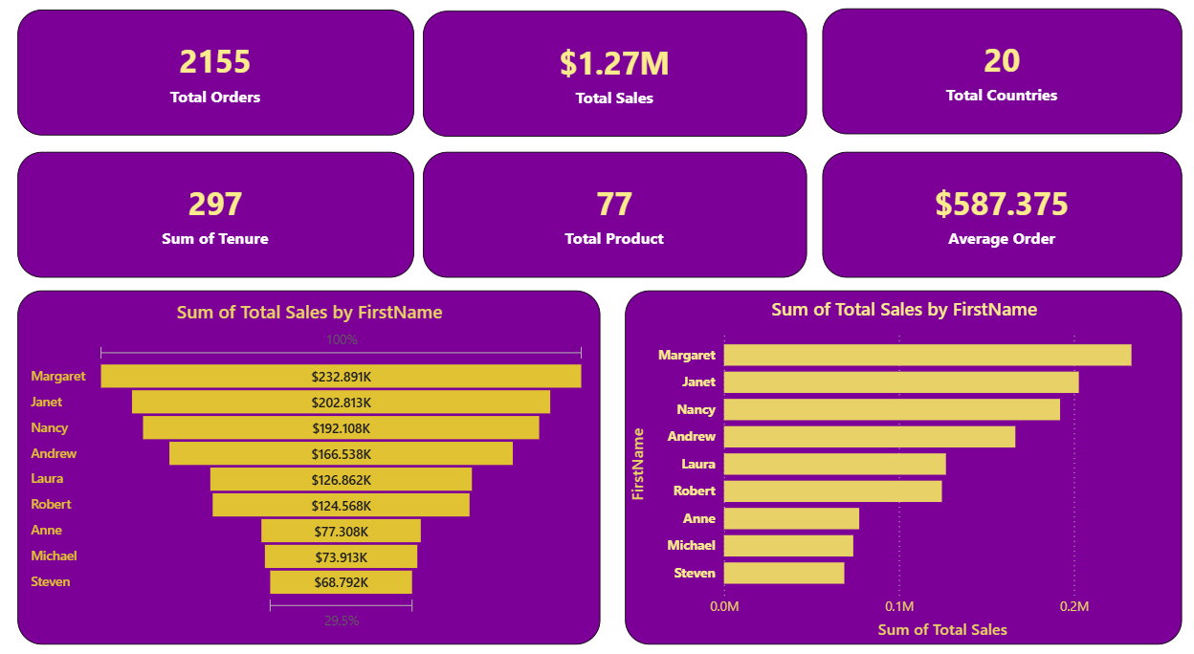
Employee Insights:-

Slide 11
Impact and Applications:-
This project demonstrates the use of data analysis tools to extract meaningful insights from sales data. Sales analytics helps businesses understand revenue trends, customer behavior, product performance, regional sales, and profitability. By analyzing sales patterns and business performance, organizations can make data-driven decisions to improve customer satisfaction, optimize inventory, increase operational efficiency, and maximize revenue and profit. Sales analytics is widely used in customer analysis, demand forecasting, inventory management, business reporting, and strategic decision-making.
Revenue Optimization :-
Sales analytics helps businesses identify high-performing products, profitable customer segments, and strong sales regions. This enables companies to focus on strategies that maximize revenue and profitability.
Product Performance Analysis :-
By analyzing product sales and demand trends, companies can identify top-selling and low-performing products. This helps improve product planning, pricing strategies, and inventory management.

Slide 12
Customer Analysis :
Sales analytics helps organizations understand customer purchasing behavior, preferences, and buying patterns. Businesses can use these insights for customer segmentation, personalized marketing, and customer retention strategies.
Inventory and Supply Chain Management
Sales analytics supports better inventory planning by predicting product demand and identifying stock shortages or excess inventory. This improves supply chain efficiency and reduces operational costs.
Regional and Market Analysis
Businesses can analyze sales performance across different cities, regions, or markets to identify high-growth areas and expansion opportunities.

Slide 13
Time-Based Trend Analysis
Sales data analysis helps organizations understand seasonal trends, festival demand, and peak sales periods. This supports better forecasting and business planning.
Business Decision-Making
Interactive dashboards and KPI monitoring enable management to make faster and more accurate business decisions based on real-time insights and performance metrics.
Profitability Improvement
Sales analytics helps identify loss-making products, inefficient operations, and low-performing regions, enabling businesses to improve overall profitability and operational efficiency.

Slide 14
Future Scope :-
The future scope of sales analytics is vast and continuously growing due to advancements in technology and the increasing importance of data-driven business decisions. Modern organizations are increasingly using advanced analytics techniques to improve sales performance, customer experience, and business profitability. Here are some key areas where sales analytics is expected to evolve:
Artificial Intelligence and Machine Learning
AI and machine learning can help businesses predict customer behavior, forecast sales trends, recommend products, and automate decision-making processes. These technologies improve the accuracy of sales forecasting and customer targeting.
Big Data and Cloud Computing
The integration of big data and cloud computing enables organizations to process and analyze large volumes of sales data efficiently. This supports real-time analytics, scalable reporting systems, and faster business insights.

Slide 15
Customer Behavior Analytics
Future sales analytics systems will focus more on understanding customer preferences, purchasing patterns, and personalization strategies to improve customer satisfaction and retention.
Real-Time Dashboards and Automation
Businesses are increasingly adopting real-time dashboards and automated reporting tools to monitor KPIs, sales performance, and inventory status instantly for faster decision-making.
Predictive and Prescriptive Analytics
Future systems will not only analyze past sales data but also predict future trends and recommend actions to improve revenue, inventory management, and marketing strategies.
Integration with IoT and Digital Platforms
Sales analytics can be integrated with e-commerce platforms, mobile applications, and IoT-based systems to collect real-time customer and transaction data for more accurate business analysis and forecasting.

Slide 16
Conclusion :-
In this sales analytics project, I analyzed sales data collected from AccioJob to understand business performance, customer behavior, product demand, and revenue trends. The analysis revealed important insights related to sales growth, top-performing products, customer purchasing patterns, regional performance, and profitability. Notably, I identified high-revenue product categories, valuable customer segments, and time-based sales trends that significantly impact overall business performance. These findings can help organizations improve decision-making, optimize inventory management, enhance customer targeting strategies, and increase profitability. Based on the analysis, I recommend businesses continuously monitor sales KPIs and use data-driven strategies to improve operational efficiency and business growth.

Slide 17
Thank you

